Slide 1
Outlier detection
蔡瑞煌

Slide 2

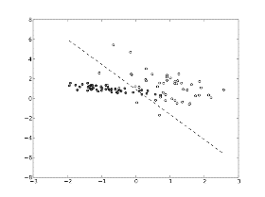
Data characteristics
Unlabeled

Slide 3


Data characteristics
Outlier candidates
14.51, 17.34, 5.33, 6.01, 0.95, 5.63, 0.98, 19.59, 6.52, 1.63, 0.66, 9.53, -0.15, -0.07, 10.16, 12.05, 6.72, 18.47, 17.17, 16.06, 5.24, 6.62, 7.24, 3.57, 17.36, 19.32, 3.79, 1.76, 8.83, 17.06, 11.18, 0.43, 4.76, 13.46, 8.69, 17.47, 20.3, 11.33, 10.33, 5.63, 17.65, -0.11, 3.07, 8.37, 15.08, 17.9, 6.53, 4.77, 10.55, 1.52
-0.15, -0.07, 20.3, -0.11
Majority
Time series data
14.51, 17.34, 5.33, 6.01, 0.95, 5.63, 0.98, 19.59, 6.52, 1.63, 0.66, 9.53, 10.16, 12.05, 6.72, 18.47, 17.17, 16.06, 5.24, 6.62, 7.24, 3.57, 17.36, 19.32, 3.79, 1.76, 8.83, 17.06, 11.18, 0.43, 4.76, 13.46, 8.69, 17.47, 11.33, 10.33, 5.63, 17.65, 3.07, 8.37, 15.08, 17.9, 6.53, 4.77, 10.55, 1.52
Algorithm

Slide 4
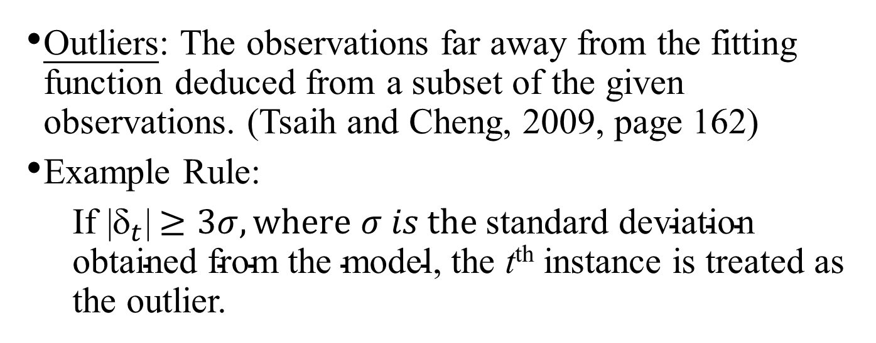
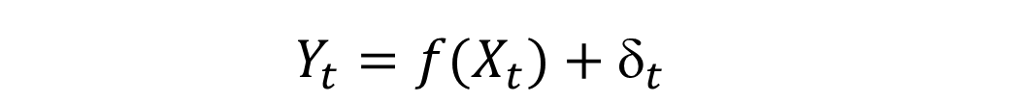
Outlier
$$Y_{t}=f(X_{t})+_{t}$$
Outliers: The observations far away from the fitting function deduced from a subset of the given observations. (Tsaih and Cheng, 2009, page 162)
Example Rule:
If |$_{t}$|$≥3σ, where σ is \text{the} \text{standard} \text{deviation} \text{obtained} \text{from} \text{the} \text{model}$, the t^{th} instance is treated as the outlier.

Slide 5

Keep Vs. Take Out !?
To purify the data for processing.
Data cleansing in data mining → then data modeling
Outliers will diminish forecast accuracy in time series data. (Chen and Liu, 1993)
One nurse responded $42,000 as her hourly rate, now that’s one well paid nurse!
Averaged wage about $12.00 per hour with a standard deviation of about $2.00.
(Brewer, Nauenberg, & Osborne, 1998)
Notes:
In cases like that of the nurse who made $42,000 per hour, another option is available-- recalculation or re-estimation of the correct answer
Unfortunately for her (and the researchers) this was not the case she hadn’t read the question properly and misreported in her answer

Slide 6
Outlier detection
Outlier detection: Task as detecting and removing anomalous observations from data. (Hodge and Austin, 2004)
anomaly detection, noise detection, deviation detection, and exception mining
In specified domain: intrusion detection, fraud detection, fault detection …
Outlier Detection Method
Statistical methods
Evolutionary algorithms
Clustering methods
Artificial neural networks
Notes:
resistant learning mechanism 晚點談

Slide 7
Evolutionary algorithms
Crawford and Wainwright’s research (1995): the best combination is genetic algorithm and Cook’s squared distance formula (Cook and Weisberg, 1982).
Srinoy (2007) implemented a supervised two-phased method to cope with intrusion detection in networking security.
This method use particle swarm optimization to select the feature for support vector machine to classify the intrusion from others. (KDD 99 data set)
Banerjee’s (2012) continuous research has combined genetic algorithm with Euclidean distance due to the feature of density-based distance.
Notes:
Crawford and Wainwright’s research (1995): But this experiment only performed in small case.

Slide 8
Peer group analysis
Ferdous and Maeda (2006) implement peer group analysis (PGA) to cope with fraud detection in financial time series data.
Kinds of unsupervised technique featuring its mechanism as identifying peer groups for all the target object
Notes:
比單純的 PSO , SVM 好很多This method use particle swarm optimization to select the feature for support vector machine to classify the intrusion from others

Slide 9
k-means clustering
Yoon, Kwon and Bae (2007) tried to use k-means clustering method to detect outliers in software measurement data.
The last process of this approach will export an outlier candidate report, this report is still need to be reviews by the domain expert.

Slide 10
Artificial neural networks
Sykacek (1997) used a neural network and sigmoid activations to cope with outlier detection problems, where neural network is trained by Bayesian interface.
Williams and Baxter (2002) use replicator neural networks (RNN) to measure whether the instance is an outlier or not.
The RNN which they proposed is a feed-forward multi-layer perception with three hidden layers between input and output layer.
During the RNN is training, the weights of RNN are adjusted to minimize the mean square error.
The aforementioned works use the pre-specified and fixed network during the training process. They can merely adjust or tuning the weights.
Notes:
Robust learning 強健學習
The survey mentioned above, their neural network don’t deal with the resistant learning problems. The most technique they used is pre-specified and fixed during the training process.

Slide 11
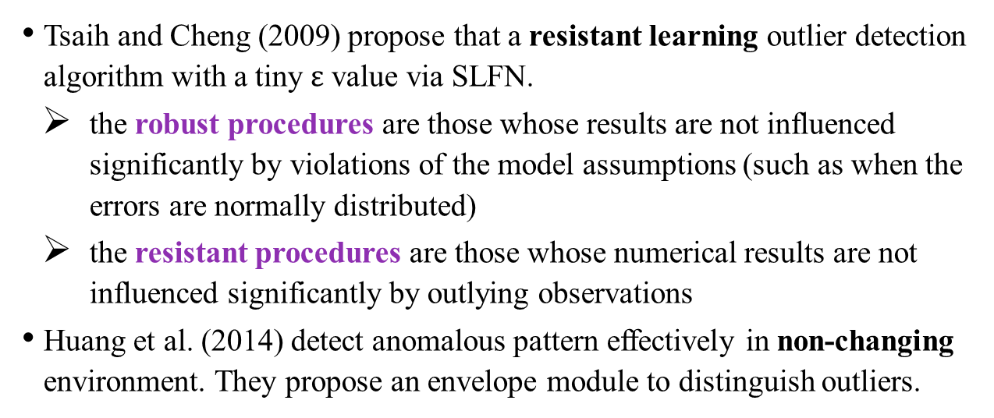
Artificial neural networks
Tsaih and Cheng (2009) propose that a resistant learning outlier detection algorithm with a tiny $ε$ value via SLFN.
the robust procedures are those whose results are not influenced significantly by violations of the model assumptions (such as when the errors are normally distributed)
the resistant procedures are those whose numerical results are not influenced significantly by outlying observations
Huang et al. (2014) detect anomalous pattern effectively in non-changing environment. They propose an envelope module to distinguish outliers.
Notes:
先前研究 最主要有兩篇 09年 14年
09年 實踐了resistant learning 14年用了信封模組 兩者晚點會細談
累進學習(Accumulative Learning)，廣義地是指某人創造了一個新產品後，他人再就原始創意加以改良革新、補強，來增加原設計的價值，這樣能刺激更多的改良革新、修改調整、輔助加強，不斷地累進學習，改良的產品就愈好，喜歡用的人就會愈多，則商機就會愈大，進而參與改良的人就愈多，於是形成了不斷的良性循環，正回饋如雪球般愈滾愈大。
https://www.facebook.com/blindfish/posts/241834062674153

Slide 12
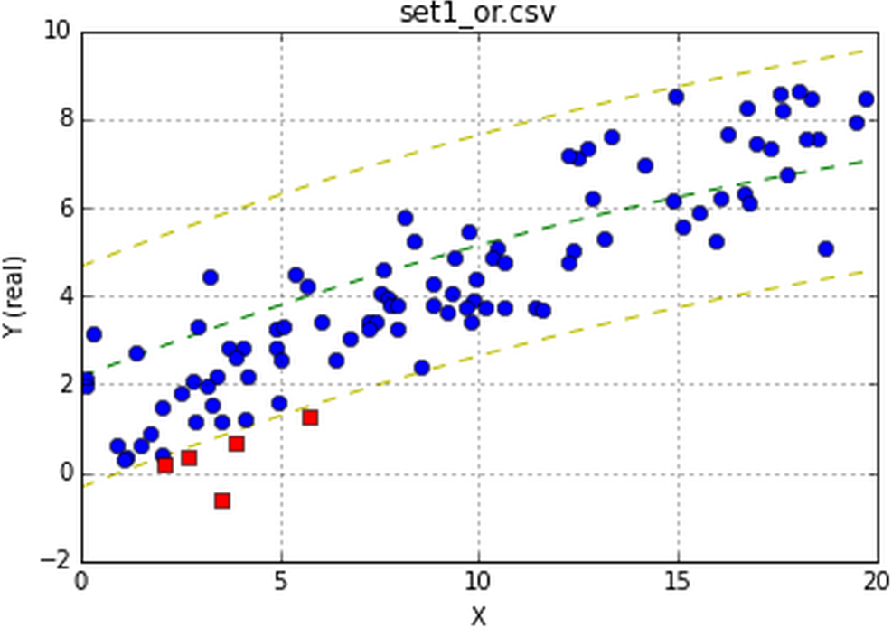
Envelope module
The envelope module allow us to wrap the response elements seen as inliers in the envelope.

Slide 13
Artificial Neural Networks
Tsaih, Rua-Huan, Huang, Shin-Ying, Lian, Mao-Ci and Huang, Yennun (2018). “ANN Mechanism for Network Traffic Anomaly Detection in the Concept Drifting Environment,” IEEE DSC 2018, pp. 1-6, 2018.
Shin-Ying Huang, Jhe-Wei Lin, Rua-Huan Tsaih (2016). “Outlier Detection in the Concept Drifting Environment,” the International Joint Conference on Neural Networks (IJCNN), pp. 31-37.
Notes:
Labeled data
-------------------刪除--------------
The first one criteria is evaluating an expected error rate.
The second one is observing the classification decision’s fraction whether or not below a given threshold.
--------------------------
定期更新 有點像囉!!!

Slide 14
Where we are now...
The second new learning mechanism
(in flowchart)
Cramming(x^{[n+1]})
Restore w
The trimmed_batch with n+1 training data of I(n) ∪ {[n+1]}
cram only one unacceptable training data
A
U
Reorganizing _n+1_r_EU(shorter)_w_EU(shorter)
Weight-tuning(n+1)
Save w
justification for overfitting
False
Reorganizing less exquisitely
Reorganizing _n_r_EU(longer)_w_EU(longer)
n < p+1+p(m+1)
True
False
True
Acceptable model
Reorganizing more exquisitely
n ≥ N
STOP
n = Obtaining_LTS
Initializing
Training data
14

Slide 15
The second new learning mechanism for outlier detection
(in flowchart)
Assumption: at most 3% data are outliers
Cramming(x^{[n+1]})
Restore w
The trimmed_batch with n+1 training data of I(n) ∪ {[n+1]}
cram only one unacceptable training data
A
U
Reorganizing _n+1_r_EU(shorter)_w_EU(shorter)
Weight-tuning(n+1)
Save w
justification for overfitting
False
Reorganizing less exquisitely
Reorganizing _n_r_EU(longer)_w_EU(longer)
True
n < p+1+p(m+1)
False
Reorganizing more exquisitely
n ≥ 0.95N
True
STOP
Acceptable model
n = Obtaining_LTS
Initializing
Training data
15

Slide 16

Where we are now...
The third new learning mechanism
(in flowchart)
Acceptable SLFN
STOP
回傳一個data subset(有n個可接受的data)
True
n > N
False
Selecting
learning goal
False
Save w
n+1$→$n
U
A
True
Weight-tuning
A
n = obtaining_LTS
Reorganizing
Cramming
Restore w
A
U
Initializing
可以只回傳n值
Training data
16

Slide 17
The third new learning mechanism for outlier detection
(in flowchart)
Acceptable SLFN
STOP
Assumption: at most 3% data are outliers
True
n > 0.97N
False
Selecting_LTS
learning goal
False
Save w
n+1$→$n
U
A
True
Weight-tuning
A
n = obtaining_LTS
Reorganizing
Cramming
Restore w
A
U
Initializing
Training data
17

